Slide 1
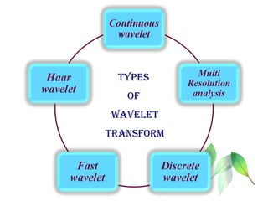
Wavelet
a wavelet to be a little part of a wave
Wavelet transform is the decomposition of a signal to the frequency components.
A wavelet transform decomposes a signal into a set of basic functions. These basic functions are called the “wavelets”
a discrete wavelet transform is used to decompose signals into sets

